Slide 1
Can we correlate RNA expression and DNase hypersensitivity sites in DNA domains?
David John Haan
Stuart’s Lab
Nov 20, 2014
UCSC
Notes:
Spearman's rank correlation rho
data: 1/test$V1 and test$diff
S = 422844, p-value = 0.00225
alternative hypothesis: true rho is not equal to 0
sample estimates:
rho
0.2482439

Slide 2
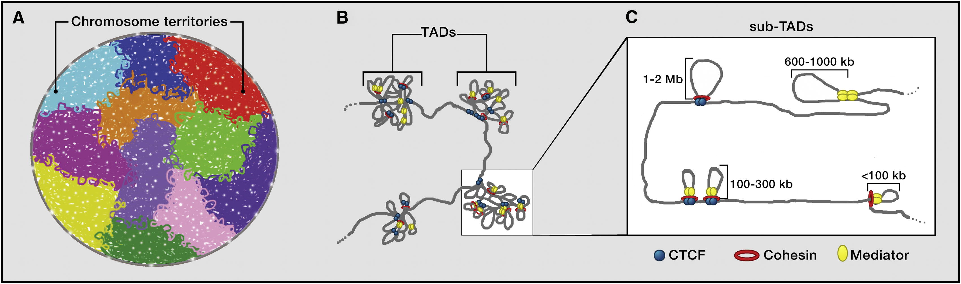
Topological Associated Domains (TAD)
Megabase-sized local chromatin interaction domains
Determined thru HiC Assay
Notes:
Topological domains: large megabase-sized chromatin interaction domains
Stable across different cell types and highly conserved across species
* We want to see if those domains are interacting are actually being transcribed

Slide 3
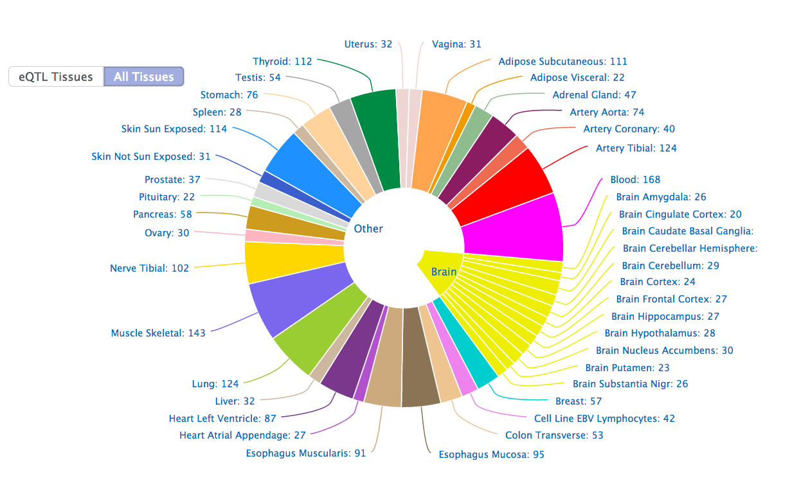
GTEX Portal RNAseq Data
2,921 samples

Slide 4
“Wrangle” the Data!
HiC Assay Domain data:
GTEX RNAseq Data in RPKMs:
Take the mean of each domain and each tissue type
chr14_24960000_26280000 | CMA1 | CTSG | GZMH | GZMB | STXBP6
chr14_26560000_28200000 | MIR4307 | NOVA1
chr14_29080000_30080000 | FOXG1 | C14orf23 | MIR548AI | PRKD1
chr14_30160000_30920000 | MIR548AI | PRKD1
Gene | Pancreas1 | Pancreas2 | Heart1
CMA1 | 61.305 | 44.22 | 17.085
CTSG | 100.5 | 21.105 | 53.265
GZMH | 4.02 | 86.43 | 89.445
GZMB | 64.32 | 85.425 | 39.195
STXBP6 | 14.07 | 97.485 | 8.04
Notes:
Take the mean of each domain
Reads per kilobase per million of mRNA
----- Meeting Notes (11/18/14 15:10) -----
pancreas has a large number of exposed domains

Slide 5
GTEX RNAseq expression in 150 most variable domains
High Expression
DNA Domains
Low Expression
Tissue Type
Notes:
----- Meeting Notes (11/18/14 15:10) -----
include epigenomic features like chromatin…
Chromatin features are left out of paradigm….
Biology:
Pancreas: most differentially expressed domain
is the REG (regenerating) gene family on chr2
Which encodes small multi-function
Proteins ; down-regulated in
gastric cancer (Choi et al.) ; aberrant expression
Profiles in colorectal cancer (Zheng el al.)

Slide 6
DNase Hypersensitivity Sites
DNase HS assay is an adequate assay to determine if a domain is open for transcription
These 5 tissue samples are from the Human Epigenome Atlas
Notes:
DNA hypersensitivity sites are portions of the chromosome open for transcription
pancreas has higher percentage of accessible
pancreas has a large number of exposed domains

Slide 7
Pancreas DNase coverage Vs RNA level
Points in red are significantly (p<.05) more expressed in Pancreas than other tissues determined by a right sided t-test.
Notes:
Genes are epxressed when chromatin is open

Slide 8
How does pancreas HS coverage in DNA domains differ from other tissue types?
Notes:
The domains on the right aremore open in pancreas and the domains on the left are more closed in pancreas….

Slide 9
Pancreas HS differential in significantly expressed Domains
SOX9 – progenitor gene
REG Family
Notes:
Upregulated with p value of .01 , -12 is more strigent, and we see more and more
----- Meeting Notes (11/18/14 15:10) -----
percentage increase of
left sided t test
show dna hypersensitivy;

Slide 10
More tests: Heart and Ovary

Slide 11
Future direction
Use more DNase hypersensitivity data
Gene-specific analysis
Analyze tissue specific “closed” domains
Compare domains among tissue types including cancer
Integrating domains into pathway models

Slide 12
Thank you
Josh’s lab specifically Josh Stuart, Dan Carlin, Kiley Graim, and Evan Paull
Charles Markello for helping create the t-test
Evan for helping determine what I need (or don’t need) on my bike to get up the hill faster
Notes:
Josh Stuart’s lab, specifically:
Dan Carlin for teaching me what “p-value” means
Kiley for teaching me what “wrangling” means
Evan for teaching me what I need to put on my bike so I can get up the hill faster

Slide 13
Pancreas HS differential VS significantly expressed Breast domains
In black is the Dnase HS coverage differential plot
In red/blue is a density plot of significant expression levels
*No Correlation!!!
Notes:
Delete…

